Slide 1

Predicting benefit of psychedelic integration
DSC 630 : Predictive analytics
Term Project
Deborah young
Notes:
Welcome everyone to this presentation on "Predicting the Benefit of Psychedelic Integration."
My name is Deborah Young, and this research is part of my term project for DSC 630: Predictive Analytics.
We will explore how psychedelics can improve mental, emotional, and spiritual health.

Slide 2
Naturalized use of psychedelics correlated with improved mental, Emotional & spiritual health
Getting the most out of life is a noble goal for any person, but, in an age of disconnection, what avenues are available to us for improving our experience?
Psychedelic integration in lifestyle is not a new development, but the effort to integrate them for legal medical practice in the US is gaining momentum. (NBC News, 2017)
The current-day exploration by medical professionals to utilize these substances for improving quality of life holds promising outcomes (MAPS Bulletin, 2022)
Mental Health: Medical professionals are increasingly looking at psychedelics to treat conditions like PTSD, depression, and anxiety. Clinical trials using substances like psilocybin and MDMA have shown promising results.
Spiritual Growth: For those seeking spiritual enlightenment or a deeper connection with themselves, guided psychedelic experiences can foster these connections.

Slide 3
“An exploration of naturalistic psychedelic use”
by Andrew McGahan, M.S. Primary supervisor: Seth Harty Associate supervisor: Virginia McIntosh
University of Canterbury Department of Psychology, Master of Science
(An Exploration of Naturalistic Psychedelic Use, 2023)
Observations include:
Lifetime usage of psychedelic and non-psychedelic substances
Intention for partaking in psychedelic use
Experience before, during, after usage
Impact on mental, emotional, physical, and/or spiritual health
Research Gap: Despite the growth in research into the therapeutic uses of psychedelics, there hasn’t been much focus on understanding the impact of users outside of clinical research.
Objective: The study aims to expand knowledge about why and how people use psychedelics and the long-term effects, which could contribute to debates on decriminalization and legalization, and promote safe usage.
Method: A mixed methods exploratory approach was used, involving an online survey (N = 603) and follow-up interviews (N = 26), with a primary focus on analyzing the interview data.

Slide 4
APPROACH
Method: A mixed methods study consisting of an online survey (N = 603) and follow-up semistructured interviews (N = 26) was conducted to broadly explore participants’ psychedelic use and its long-term effects.
Feature Selection:
An attempt to use Recursive Feature Elimination (RFE) and stepwise regression, both of which failed due to computational or other issues.
A correlation matrix was used to select features with a correlation cutoff of 0.75.
Data Splitting:
The data was split into training and testing sets using an 80/20 ratio.
Model Building and Evaluation:
SVM Model: An SVM model was trained, evaluated, and achieved a specific accuracy. A confusion matrix was printed.
KNN Model: A k-Nearest Neighbors model was trained with k=5, and its accuracy and ROC curve were evaluated.
Random Forest Model: A Random Forest model was trained, predictions were made, and an ROC curve was plotted.
GBM Model: A Gradient Boosting Machine model was trained for a binary classification task (Bernoulli distribution).

Slide 5
Results
The Random Forest model is trained on the 80-20 split of the dataset, with the target as a binary variable for the value of Q88 set to “76-100%” (“What proportion of your psychedelic experiences would you rate as being beneficial to you in some way?”) . The confusion matrix and related statistics are provided:
Accuracy: 98.32%
Sensitivity: 94.12% (true positive rate)
Specificity: 100% (true negative rate)
Positive Predictive Value: 100% (precision)
Negative Predictive Value: 97.70%
Balanced Accuracy: 97.06%
The Receiver Operating Characteristic (ROC) curve is again evaluated, with an Area Under the Curve (AUC) score of 0.9706.
RandomForest model showed significant improvements over the previous models and is characterized by high accuracy and predictive power.

Slide 6
GOALS AND POTENTIAL FOR FUTURE
This result gives me hope that in future implementation of psychedelic use for mental health, a machine learning model may be able to predict the likelihood of a positive outcome for individuals’ integration of psychedelics.
The potential capability to predict likelihood of a positive experience and/or the lasting impact on a person’s health will be extremely beneficial in personalized medicine.
“Expanding our understanding of how and why people use psychedelics and the long-term impact of their use, will help provide more detailed and accurate information that can help inform the larger decriminalization/legalization debate and enhance the safety of naturalistic psychedelic use.” (An Exploration of Naturalistic Psychedelic Use, 2023)

Slide 7
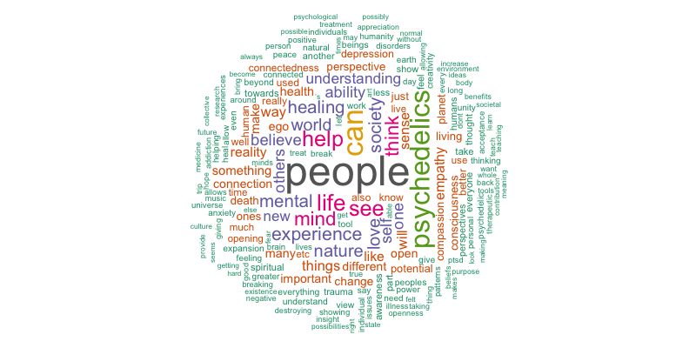
“What do you believe are psychedelics most important contribution to society?” – Survey q91 (An Exploration of Naturalistic Psychedelic Use, 2023)
“Results: Two major themes related to long-lasting effects of naturalistic psychedelic use were identified. The first major theme identified psychedelic use as an activity that transforms participants’ perspective of themselves, others, and the world, leading to the second major theme wherein participants experienced an overall improvement in the quality of their lives.” (An Exploration of Naturalistic Psychedelic Use, 2023)
Wordcloud of responses to Q91, developed in R

Slide 8
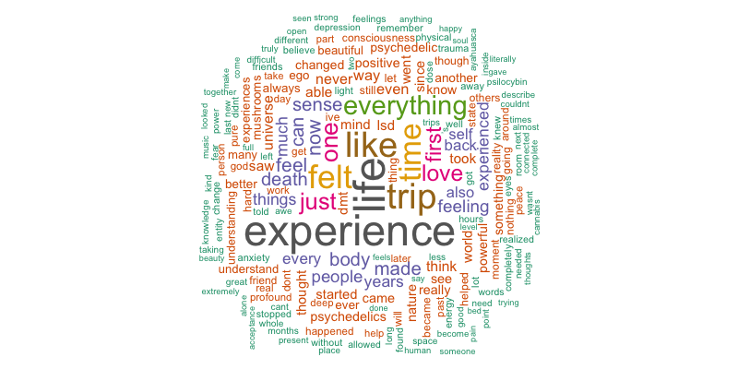
Can you describe your most powerful positive psychedelic experience and any enduring changes you attribute to having that experience? -Survey Q93 (An Exploration of Naturalistic Psychedelic Use, 2023)
“Participants most commonly reported that their use of psychedelics was for self-exploration, self-development, and therapeutic purposes. Findings from the thematic analysis indicate that psychedelics facilitate a shift in participants’ perspective (e.g., thoughts and feelings) of themselves, others, and the world. This perspective shift leads the majority of users to experience a sustained improvement in their quality of life which is facilitated and sustained by a more positive outlook on life, greater acceptance of oneself and others, reduced avoidance of negative emotions, an enhanced sense of connection to oneself, others, and the world, improved interpersonal relationships, improved mental health, and a greater degree of self-understanding. Although, a minority of users report long-lasting negative effects, our findings suggest that naturalistic psychedelic benefits the majority of users by generating personally meaningful experiences that draw on users’ past experiences, belief systems, and intentions.” Paraphrased. (An Exploration of Naturalistic Psychedelic Use, 2023)
Wordcloud of responses to Q93, developed in R

Slide 9
references
An Exploration of Naturalistic Psychedelic use. (2023). figshare. https://doi.org/10.6084/m9.figshare.21708044.v1
MAPS Bulletin 2022: Vol 32, No. 2. (2022, November 3). Multidisciplinary Association for Psychedelic Studies - MAPS. https://maps.org/news/bulletin/maps-bulletin-2022-vol-32-no-2/
NBC News: Will Psychedelic Therapy Transform Mental Health Care? (2017, September 29). Multidisciplinary Association for Psychedelic Studies - MAPS. https://maps.org/news/media/will-psychedelic-therapy-transform-mental-health-care/

